Slide 1
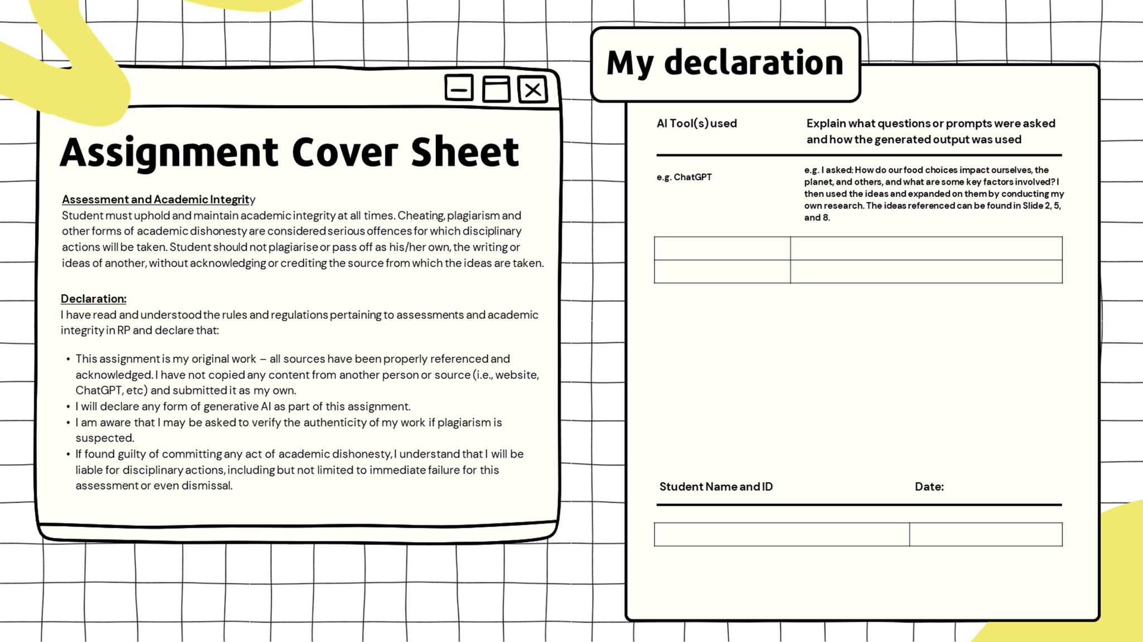
Adhav Anbalagan | 24012794
May 9, 2024

Slide 2
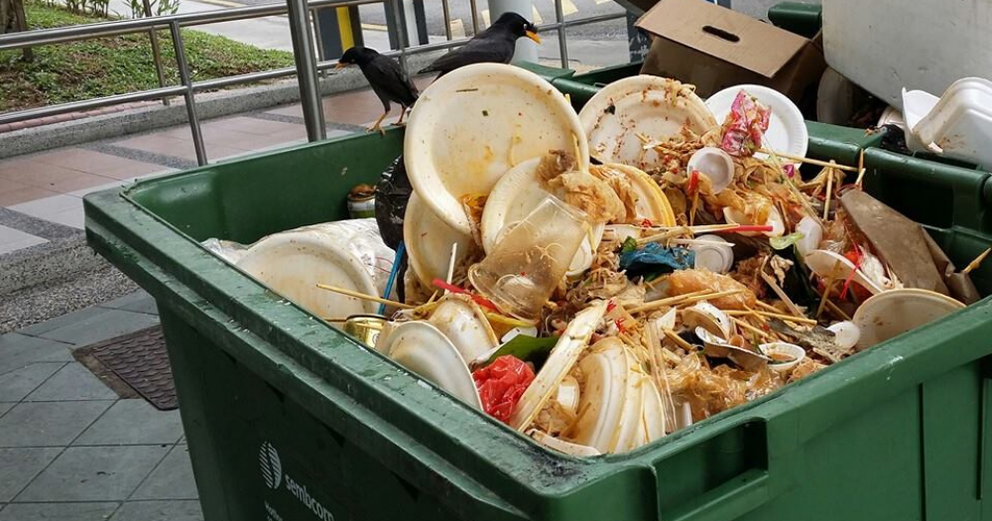
1: PDT Template (Interpret)
PROBLEM:
What I Know | What I Do Not Know | What I Need To Find Out
The larger the distance the food travels, the increased number of environmental impacts. | How much food waste is generated at RP? | Stakeholders in RP that contribute to food sustainability
Although processed food is an alternative to reduce food wastage, it’s deemed unhealthy due to its large traces of sugar, fats and salts. | What is RP doing to improve its food sustainability? | What are other polytechnics doing to advance their food sustainability
An abundance of resources are wasted as more and more food is being thrown away. | Do RP students follow food sustainability methods? | What are some effective strategies to reduce food wastage
The Singapore Green Plan 2030, is a movement led by five of Singapore’s ministries to advance the nation’s sustainability. | How much of RP’s food comes from afar? | Efficient ways to ensure students follow such food sustainability practices
For the reason that our food has been growing in accessibility, problems arise. With environmental, social and economic factors in consideration, food being wasted can impact many things. Not only does it affect us, it affects others, our economy and the planet!
TASK!
Present the factors and stakeholders related to food sustainability in Singapore and RP, what actions can RP take to practise sustainability and produce solutions for an array of shareholders.

Slide 3
2: Facts & Statistics (Investigate)
Information & Statistics | Links to Sources
According to the National Environment Agency (updated as at April 2024), the total amount of food waste generated in 2022 was 813 000 tonnes, a 9.27% increase from 744 000 tonnes generated in 2019. | https://www.nea.gov.sg/our-services/waste-management/3r-programmes-and-resources/food-waste-management#:~:text=The%20total%20amount%20of%20food,waste%20was%2018%20per%20cent.
According to the Singapore Food Statistics 2021, published by the Singapore Food Agency in August 2022, over 90% of our food today is imported. | https://www.sfa.gov.sg/docs/default-source/publication/sg-food-statistics/singapore-food-statistics-2021.pdf
According to the National Environment Agency (updated as at April 2024), about 11 percent of waste generated in Singapore in 2022 was contributed by food wastage. | https://www.nea.gov.sg/our-services/waste-management/3r-programmes-and-resources/food-waste-management
According to the Resource Sustainability (Food Waste Segregation, Treatment And Reporting) Regulations 2024 (as at May 24, 2024), more than 3000 sqm of commercial buildings are required to segregate their food waste for treatment and reporting. | https://sso.agc.gov.sg/SL/RSA2019-S194-2024

Slide 4

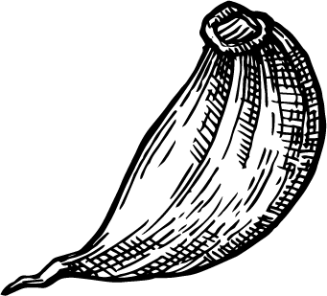
NESTED DIAGRAM
3: Nested Diagram (Investigate)
Individual
Community
National
Global
Students frequently order more than they can stomach! This leads to us wasting food that we cannot finish.
School, IGs, CCAs, CCs
Singapore
International
To promote food sustainability amongst communities, food waste initiatives can be formed. This allows people of various communities to take action and engage in conversation about food sustainability.
Policies can be created to manage food importing and launch campaigns encouraging citizens to support local food businesses.
Food sustainability practices can be shared between recognised countries to promote healthy living, and combat global warming.

Slide 5
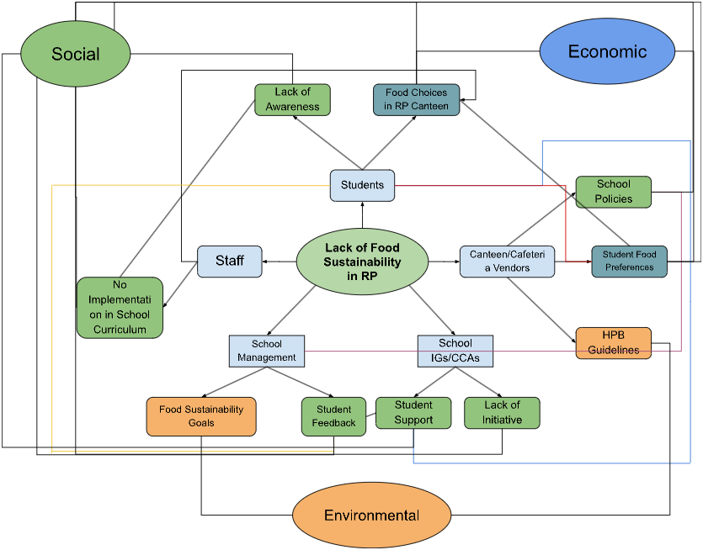
4: Interrelationship Diagram (Analyse)
Light Blue Rounded Rectangles:
Stakeholders
Ovals (Social, Economic, Environmental):
Factors
Light Green Rounded Rectangles:
Relating to Social Factor
Light Orange Rounded Rectangles:
Relating to Environmental Factor
Light Cyan Rounded Rectangles:
Relating to Both Social & Economic Factors

Slide 6
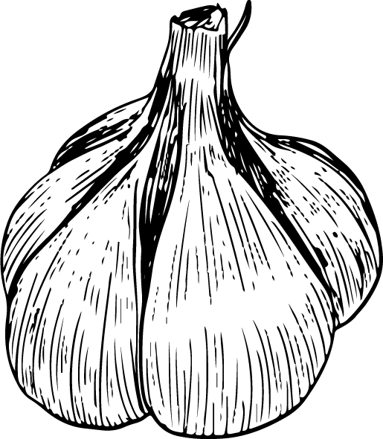
5: Interrelationship Diagram #1 (Analyse)
Lack of Awareness: Students may not be familiar with food sustainability practices, or understand how food is being wasted, especially at a large quantity.
Food Choices in RP Canteen: Students and staff may not visit certain stalls in canteens, dependent on their mood or preference of food. This leads to the stall owner having to discard leftover food if there is an insufficient number of customers purchasing their dishes.
No Implementation in School Curriculum:
RP staff may not be doing enough to implement topics such as food sustainability in modules which could lead to a lack of awareness regarding the subject amongst students.

Slide 7
6: Interrelationship Diagram #2 (Analyse)
School Policies:
School Policies may restrict vendors to sell food at certain times of the day, or keep a certain quantity of food in school.
Student Food Preferences:
Vendors curate their menus based on what students and staff prefer or what is popular. If the menus are disorganised or unclear, or if the dishes are not to the individual’s liking, it leads to a decline in sales and hence, leaves them no choice but to throw away food.
HPB Guidelines:
The food being sold at school cafeterias have to follow certain guidelines and specifications including nutrients, to ensure the food is healthy. As more unhealthy food is prominent amongst students, sales could be down if the stall only sells healthy food.

Slide 8
7: Interrelationship Diagram #3 (Analyse)
Food Sustainability Goals: The school may aim to reach a certain goal, hence they may enforce strict policies for vendors to follow.
Student Feedback:
Depending on the criticism of their students, the structure of cafeterias and canteens can be changed by the school management causing a drastic impact on food vendors.
Student Support:
If there is a lack of Student Support in the organisations within the school, not a lot can be done regarding food sustainability.
Lack of Initiative:
If no student leaders initiate conversations about food sustainability, or spread awareness about it, the food sustainability in RP may not be strong.

Slide 9
VIRTUOUS CYCLE
BALANCING LOOP
9: Virtuous Cycle + Balancing Loop (Evaluate)
Self-Directed Student Initiatives
Food Wastage in RP
Fee Paid to Store for Amt of Wasted Food
+
+
Virtuous Cycle
If students are encouraged to start self-initiated projects or, if its mandatory as part of curriculum, this will lead them to research about food sustainability.
This allows them to gain in-depth knowledge regarding the topic and be conscious when ordering or finishing their food. Furthermore, if they would like to spread further awareness to their peers or the community, they would start even more self-directed projects.
Increase of Awareness Regarding Food Sustainability
More and More Students Researching About Food Sustainability
+

Slide 10
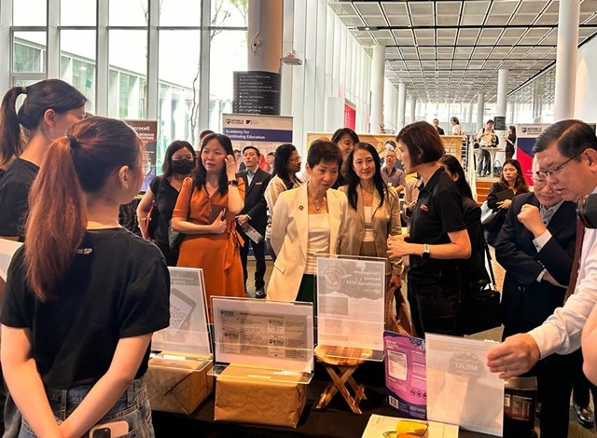
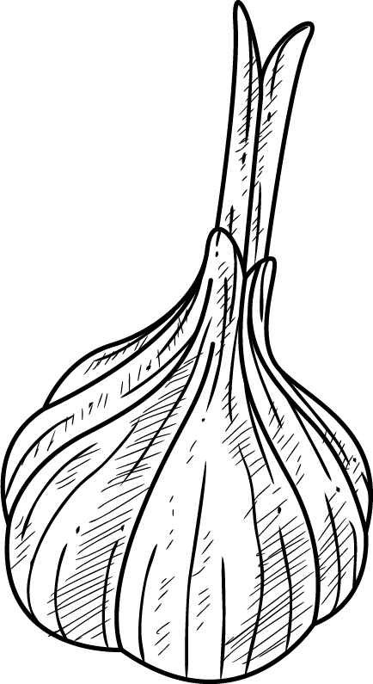
SOLUTION #1:
A Student-initiated Food Sustainability Fair
9: Solution #1 (Evaluate)
An event held by RP where students get to create products or solutions that can improve food sustainability, and showcase it to other students. Guests from government agencies can be invited to share more regarding the topic.
Benefits: Students from RP, will research and gather information regarding food sustainability. This will lead them to forming opinions and ideas of their own, possibly forming a sense of regret for wasting food in the past. This could encourage them to adopt food sustainability practices.
Singapore Polytechnic (SP) held an event similar to this in relation to food manufacturing, in 2023.
Disadvantages: It might be difficult to ensure active participation from the students and staff of the school and invite guests. Hence, the event might not reach its intended aim.

Slide 11
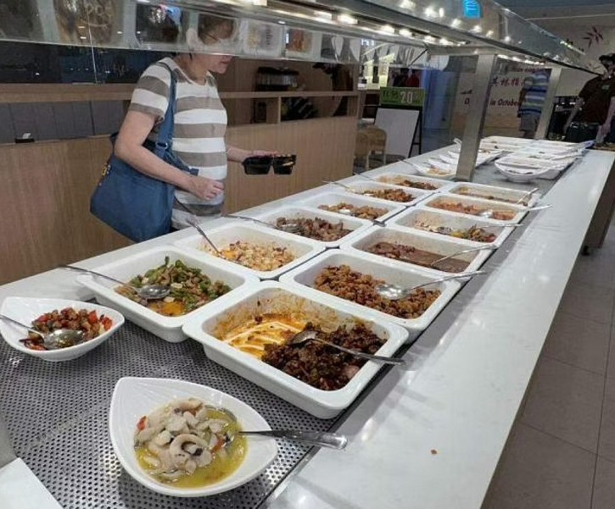
SOLUTION #2:
Charging Fees for Food Waste
10: Solution #2 (Evaluate)
If a RP student has food leftover that they have no choice but to discard, they have to pay a penalty fee. This fee is calculated based on the mass of the food being wasted.
Benefits: Students and staff from RP, will be discouraged from ordering what their heart desires and rather how much they can stomach, when they’re required to pay an extra couple of dollars. This cautiousness can lead to less food being thrown away by students and staff.
In Seoul, South Korea, customers are made to pay a “recycling fee” dependant on the food waste that they’ve produced.
Disadvantages: Students might find ways to throw their waste elsewhere without stall owners’ knowledge leading to unintended consequences.

Slide 12
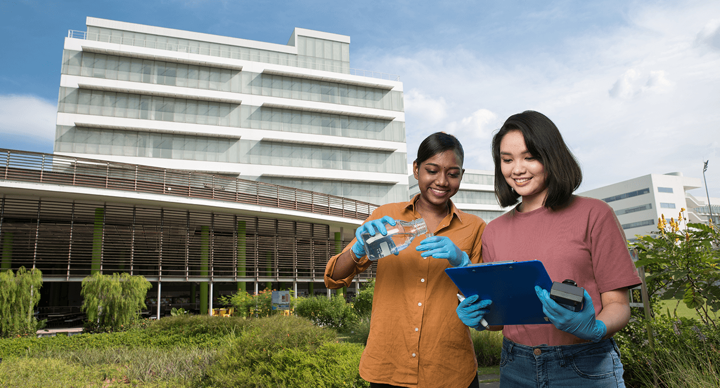
CONCLUSION
11: Conclusion (Explain)
Hence, in conclusion, by having a food sustainability fair and by charging a penalty fee for food waste, the food sustainability issues in RP can be addressed. By involving the primary stakeholders, students, staff, RP management, canteen vendors, IGs, the issue is evaluated with balanced consideration for all the parties.
As the stakeholders have a direct involvement, engaging in activities related to food sustainability, they are able to develop an in-depth understanding of the subject area, and share their newfound knowledge with their peers.
Economic Consequence: Penalty fee leading to less over-charging of food items.
Environmental Consequence: Increased knowledge about sustainability leads to reduced food waste.
Social Consequence: An atmosphere made up of students and staff promoting food sustainability.

Slide 13
References
12: References
Chong, B. (2022, September 16). Topic of Food Sustainability Is Part of Environmental Education in Schools. Retrieved May 10, 2024, from https://www.moe.gov.sg/news/forum-letter-replies/20220916-topic-of-food-sustainability-is-part-of-environmental-education-in-schools
FoodHero. (2024). 5 Countries Leading the Fight to End Food Waste. Retrieved May 10, 2024, from https://www.foodhero.com/en/blogs/countries-fighting-food-waste
Health Promotion Board. (2024, April 2). Healthy Living (Food & Beverage). Retrieved May 10, 2024, from https://hpb.gov.sg/healthy-living/food-beverage
Health Promotion Board. (2024, May 2). Healthy Meals in Schools Programme. Retrieved May 10, 2024, from https://hpb.gov.sg/schools/school-programmes/healthy-meals-in-schools-programme
National Environment Agency. (2024, April). Food Waste Management. Retrieved May 10, 2024, from https://www.nea.gov.sg/our-services/waste-management/3r-programmes-and-resources/food-waste-management
Ngee Ann Polytechnic. (2024). Sustainability Commitment (Ngee Ann Polytechnic). Retrieved May 10, 2024, from https://www.np.edu.sg/about-np/our-story/sustainability-commitment
Republic Polytechnic. (2021, January). Stepping Up For A Sustainable Future. Retrieved May 10, 2024, from https://www.rp.edu.sg/incorporate/news-and-updates/stepping-up-for-a-sustainable-future
Singapore Food Agency. (2022, June). Singapore Food Statistics 2021. Retrieved May 10, 2024, from https://www.sfa.gov.sg/docs/default-source/publication/sg-food-statistics/singapore-food-statistics-2021.pdf
Singapore Green Plan. (2024, May 16). Singapore Green Plan 2030. Retrieved May 10, 2024, from https://www.greenplan.gov.sg/
Singapore Polytechnic. (2023, November 30). Kickstarting Your Sustainability Journey in Food Manufacturing. Retrieved May 10, 2024, from https://www.sp.edu.sg/industry/news/Detail/kickstarting-your-sustainability-journey-in-food-manufacturing
Singapore Polytechnic. (2024, May 30). Sustainability Matters (Singapore Polytechnic). Retrieved May 10, 2024, from https://www.sp.edu.sg/sp/about-sp/why-sp/sustainability-matters
Stanley, L. K. L. (2024, March 6). Resource Sustainability (Food Waste Segregation, Treatment and Reporting) Regulations 2024. Retrieved May 10, 2024, from https://sso.agc.gov.sg/SL/RSA2019-S194-2024

